Slide 1
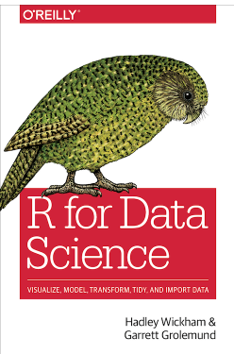
Chapters 7 Exploratory Data Analysis – Pt 1 Follow along here: https://r4ds.had.co.nz/exploratory-data-analysis.html
Source:https://r4ds.had.co.nz/

Slide 2
7.0 – 7.8 Exploratory Data Analysis
Introduction
Exploratory Data Analysis is an iterative process that helps you to: 1. Generate questions about your data.
2. Search for answers by visualizing, transforming, and modelling your data.
3. Use what you learn to refine your questions and/or generate new questions.

Slide 3
7.0 – 7.8 Exploratory Data Analysis
There are no strict set of rules for Exploratory Data Analysis (EDA).
It is an important part of data analysis.
It is a state of mind in which you’ll investigate ideas about your data.
Some will be dead ends, some will not.
Helps you to investigate the quality of your data.
Data cleaning is an application of EDA.
Puts into use visualization, transformation, and modeling.

Slide 4
7.0 – 7.8 Exploratory Data Analysis
There are no strict set of rules for Exploratory Data Analysis (EDA).
It is an important part of data analysis.
It is a state of mind in which you’ll investigate ideas about your data.
Some will be dead ends, some will not.
Helps you to investigate the quality of your data.
Data cleaning is an application of EDA.
Puts into use visualization, transformation, and modeling.
We’re going to need:
library(tidyverse)

Slide 5
7.0 – 7.8 Exploratory Data Analysis
EDA is a creative process.
It is an iterative process, based on a series of questions, that help you to guide your investigation of the data.
Specific questions help you to focus specific parts of the dataset, and help you to decide which graphs, models, or transformations to make.
Initially, it’s difficult questions, because you’re not yet sure what you’re looking for.
But as you continue to ask questions, you’ll continue to make discoveries that will guide you to what’s important in the data.

Slide 6
7.0 – 7.8 Exploratory Data Analysis
While there are no hard and fast rules for the types of questions to ask, there are two types of questions that are useful:
What type of variation occurs within my variables?
What type of covariation occurs between my variables?

Slide 7
7.0 – 7.8 Exploratory Data Analysis
Let’s define the terms:
A variable is a quantity, quality, or property that you can measure.
A value is the state of a variable when you measure it. The value of a variable may change from measurement to measurement.
An observation is a set of measurements made under similar conditions (you usually make all of the measurements in an observation at the same time and on the same object). An observation will contain several values, each associated with a different variable. I’ll sometimes refer to an observation as a data point.
Tabular data is a set of values, each associated with a variable and an observation. Tabular data is tidy if each value is placed in its own “cell”, each variable in its own column, and each observation in its own row.

Slide 8
7.0 – 7.8 Exploratory Data Analysis
Variation:
The tendency of the values of a variable to change from measurement to measurement.
If you measure any continuous variable twice, you will get two different results. Even with constants.
Each of your measurements will include a small amount of error that varies from measurement to measurement.
Categorical variables can also vary if you measure across different subjects.
Every variable has its own pattern of variation, which can reveal interesting information.
The best way to understand that pattern is to visualize the distribution of the variable’s values.

Slide 9
7.0 – 7.8 Exploratory Data Analysis
Visualizing Distributions:
Visualizations will depend on whether a variable is categorical or continuous.
A variable is categorical if it can only take one of a small set of values.

Slide 10
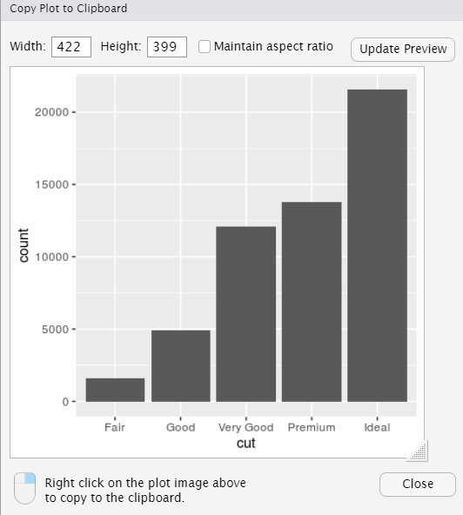
7.0 – 7.8 Exploratory Data Analysis
Visualizing Distributions:
To examine the distribution of a categorical variable, use a bar chart.
ggplot(data = diamonds) + geom_bar(mapping = aes(x = cut))

Slide 11
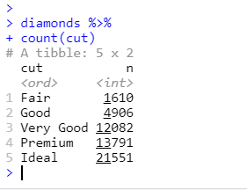
7.0 – 7.8 Exploratory Data Analysis
Visualizing Distributions:
The height of the bars displays how many observations occurred with each x value.
You can compute these values manually with dplyr::count()
Diamonds %>% count(cut)

Slide 12
7.0 – 7.8 Exploratory Data Analysis
Visualizing Distributions:
A variable is continuous if it can take any of an infinite set of ordered values.
Numbers and date-times are two examples of continuous variables.

Slide 13
7.0 – 7.8 Exploratory Data Analysis
Visualizing Distributions:
To examine the distribution of a continuous variable, use a histogram:
ggplot(data = diamonds) +
geom_histogram(mapping = aes(x = carat), binwidth = 0.5)

Slide 14
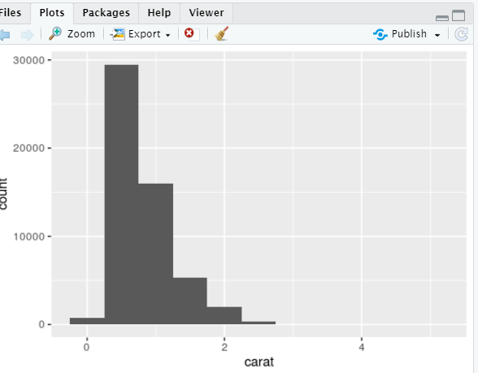
7.0 – 7.8 Exploratory Data Analysis
Visualizing Distributions:
To examine the distribution of a continuous variable, use a histogram:

Slide 15
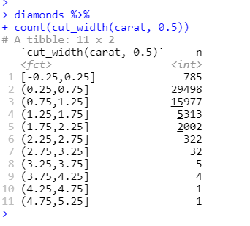
7.0 – 7.8 Exploratory Data Analysis
Visualizing Distributions:
You can compute this by hand by combining dplyr::count() and ggplot2::cut_width():
diamonds %>% count(cut_width(carat, 0.5))

Slide 16
7.0 – 7.8 Exploratory Data Analysis
Visualizing Distributions:
A histogram divides the x-axis into equally spaced bins, and then uses the height of a bar to display the number of observations that fall in each bin.
You can set the width of the intervals in a histogram with the binwidth argument. This is measured in the units of the x variable.

Slide 17
7.0 – 7.8 Exploratory Data Analysis
Visualizing Distributions:
You should always explore a variety of binwidths when working with histograms, as different binwidths can reveal different patterns.
Lets look at the same information, but at diamonds less than 3 carats, and using a smaller binwidth.

Slide 18
7.0 – 7.8 Exploratory Data Analysis
Visualizing Distributions:
smaller <- diamonds %>% filter(carat <3)
ggplot(data = smaller, mapping = aes(x = carat)) + geom_histogram(binwidth = 0.1)

Slide 19
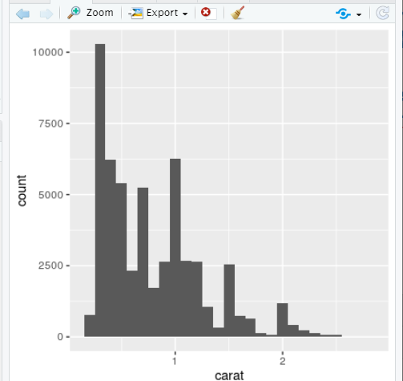
7.0 – 7.8 Exploratory Data Analysis
Visualizing Distributions:

Slide 20
7.0 – 7.8 Exploratory Data Analysis
Visualizing Distributions:
You can overlay multiple histograms in the same plot, by using geom_freqpoly() instead of geom_histogram().
Instead of displaying the counts with bars, uses lines instead. It’s much easier to understand overlapping lines than bars.

Slide 21
7.0 – 7.8 Exploratory Data Analysis
Visualizing Distributions:
ggplot(data = smaller, mapping = aes(x = carat, color = cut)) + geom_freqpoly(binwidth = 0.1)

Slide 22
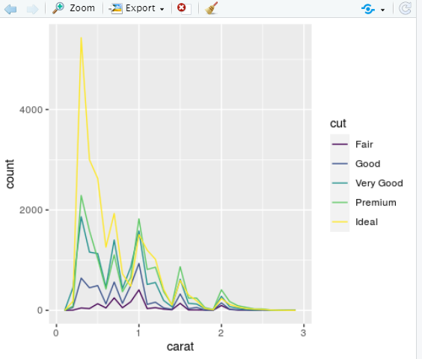
7.0 – 7.8 Exploratory Data Analysis
Visualizing Distributions:

Slide 23
7.0 – 7.8 Exploratory Data Analysis
Visualizing Distributions:
Bar charts and histograms both use tall bars to show the common values of a variable, and shorter bars show less-common values.
Places that do not have bars reveal values that were not seen in your data.

Slide 24
7.0 – 7.8 Exploratory Data Analysis
Visualizing Distributions:
To turn this information into useful questions, look for anything unexpected:
Which values are the most common? Why?
Which values are rare? Why? Does that match your expectations?
Can you see any unusual patterns? What might explain them?

Slide 25
7.0 – 7.8 Exploratory Data Analysis
Visualizing Distributions:
So, we’re going to recreate a histogram that suggests several interesting questions:
Why are there more diamonds at whole carats and common fractions of carats?
Why are there more diamonds slightly to the right of each peak than there are slightly to the left of each peak?
Why are there no diamonds bigger than 3 carats?

Slide 26
7.0 – 7.8 Exploratory Data Analysis
Visualizing Distributions:
ggplot(data = smaller, mapping = aes(x = carat)) +
geom_histogram(binwidth = 0.01)

Slide 27
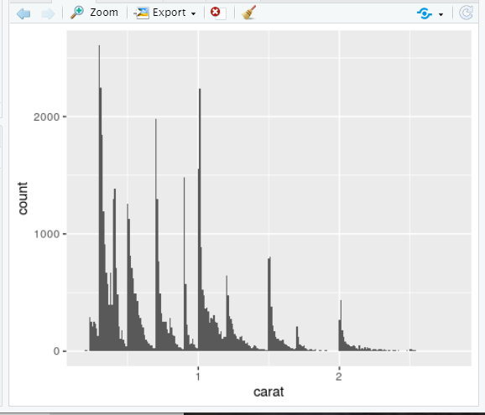
7.0 – 7.8 Exploratory Data Analysis
Visualizing Distributions:

Slide 28
7.0 – 7.8 Exploratory Data Analysis
Visualizing Distributions:
Clusters of similar values suggest that subgroups exist in your data. To understand the subgroups, ask:
How are the observations within each cluster similar to each other?
How are the observations in separate clusters different from each other?
How can you explain or describe the clusters?
Why might the appearance of clusters be misleading?

Slide 29
7.0 – 7.8 Exploratory Data Analysis
Visualizing Distributions:
Let’s create a histogram that shows the length (in minutes) of 272 eruptions of the Old Faithful Geyser in Yellowstone National Park.
Eruption times appear to be clustered into two groups: there are short eruptions (of around 2 minutes) and long eruptions (4-5 minutes), but little in between.

Slide 30
7.0 – 7.8 Exploratory Data Analysis
Visualizing Distributions:
ggplot(data = faithful, mapping = aes(x = eruptions)) + geom_histogram(binwidth = 0.25)

Slide 31
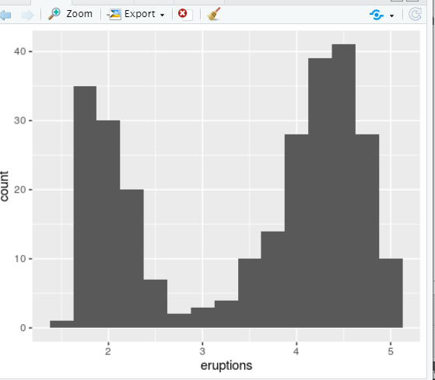
7.0 – 7.8 Exploratory Data Analysis
Visualizing Distributions:
Many of the questions above will prompt you to explore a relationship between variables, for example, to see if the values of one variable can explain the behavior of another variable.

Slide 32
7.0 – 7.8 Exploratory Data Analysis
Unusual Variables:
Outliers are observations that are unusual; data points that don’t seem to fit the pattern.
Sometimes outliers are data entry errors
Other times outliers suggest important new science.
When you have a lot of data, outliers are sometimes difficult to see in a histogram.

Slide 33
7.0 – 7.8 Exploratory Data Analysis
Unusual Variables:
As an example, take the distribution of the y variable from the diamonds dataset.
The only evidence of outliers is the unusually wide limits on the x-axis.

Slide 34
7.0 – 7.8 Exploratory Data Analysis
Unusual Variables:
ggplot(diamonds) + geom_histogram(mapping = aes(x = y), binwidth = 0.5)

Slide 35
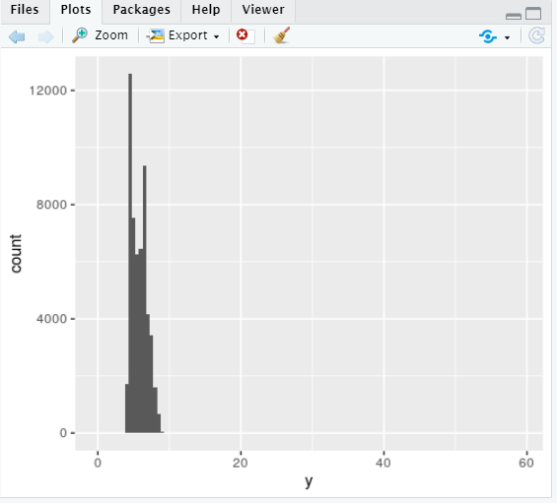
7.0 – 7.8 Exploratory Data Analysis
Unusual Variables:
There are so many observations in the common bins that the rare bins are so short that you can’t see them (although maybe if you stare intently at 0 you’ll spot something).
To make it easy to see the unusual values, we need to zoom to small values of the y-axis with
coord_cartesian()
Cartesian Coordinates

Slide 36
7.0 – 7.8 Exploratory Data Analysis
Unusual Variables:
ggplot(diamonds) + geom_histogram(mapping = aes(x = y), binwidth = 0.5) + coord_cartesian(ylim = c(0, 50)

Slide 37
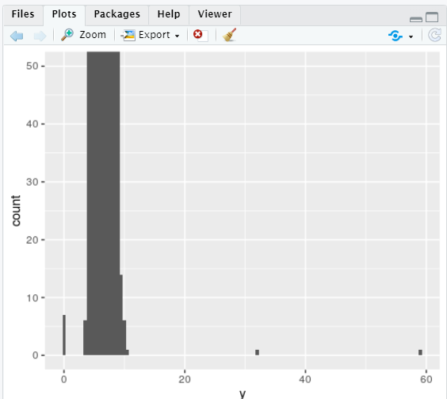
7.0 – 7.8 Exploratory Data Analysis
Unusual Variables:
coord_cartesian() also has an xlim() argument for when you need to zoom into the axis.
ggplot2 also has xlim() and ylim() functions that work slightly differently; they throw away the data outside the limits.

Slide 38
7.0 – 7.8 Exploratory Data Analysis
Unusual Variables:
So now, we can see that there are unusual variables: 0, ~30, and ~60.
We can pluck them out with dplyr:

Slide 39
7.0 – 7.8 Exploratory Data Analysis
Unusual Variables:
unusual <- diamonds %>%
filter(y < 3 | y > 20) %>%
select(price, x, y, z) %>% arrange(y)
unusual

Slide 40
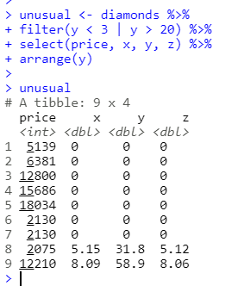
7.0 – 7.8 Exploratory Data Analysis
Unusual Variables:
The y variable measures one of the three dimensions of these diamonds, in mm.
We know that diamonds can’t have a width of 0mm, so these values must be incorrect.
We might also suspect that measurements of 32mm and 59mm are implausible: those diamonds are over an inch long, but don’t cost hundreds of thousands of dollars!

Slide 41
7.0 – 7.8 Exploratory Data Analysis
Unusual Variables:
It’s good practice to repeat your analysis with and without the outliers.
If they have minimal effect on the results, and you can’t figure out why they’re there, it’s reasonable to replace them with missing values, and move on.
However, if they have a substantial effect on your results, you shouldn’t drop them without justification. You’ll need to figure out what caused them (e.g. a data entry error) and disclose that you removed them in your write-up.

Slide 42

Resources
Data Professor
https://www.youtube.com/channel/UCV8e2g4IWQqK71bbzGDEI4Q
https://www.facebook.com/dataprofessor/

